Slide 1
Embedded Operating System
LIAO Yong

Slide 2
Chapter 3 Software System

Slide 3
1 Overview
Why Embedded Software System (ESS) ?
Running process of ESS

Slide 4
2 Why Embedded Software System (ESS) ?
Complicated development of ESS
    Comprehend the H/W & S/W (Configure and drive the H/W)
    Boot
    ……
ERTOS is a part of ESS
Development of ES is the development of a computer
Not merely the development of the application based on the ERTOS!
Specialize & Optimize the ERTOS

Slide 5

2 Why Embedded Software System (ESS) ?
“Even a fly has its spleen” (x.k, x.M) (p59)
    Bootloader: BSP (Board Support Package)
    ERTOS
    Drivers
    Application
Start up quickly
Real-time
Dependability (Reliability,Availability,Safety,Security……)
Development platform & Running platform (P59)
Integrated software

Slide 6
3 Running process of ESS (OS supported)
Power on
Why… ? (p64)
Boot
RomInit.s
SysALib.s
RomStar()
Load
SysInit()
UsrInit()
UsrkernelInit()
KernelInit()
UsrRoot()
System
Initialization
Application
Initialization
How does VxWorks begin to run on X86 ?
Multi-tasks
Application
How to specify the BSP & VxWorks ?

Slide 7
4 ESS & RTOS
Booting ARM
    Case: Boot ARM11MPCORE (4 cores) in aCoral
Uboot & Vivi ……
Booting in mini 2440
    Boot from Norflash or Nandflash ?
    How many jobs are indispensable to run the UART?
    How to set the interrupt vector,watchdog,timer,RAM,stack?
Q & A

Slide 8
4 ESS & RTOS
Port the RTOS (uc/OS II) on ARM
    OS_CPU.H
    OS_CPU_C.C
      OStaskStkInit()
      ……
    OS_CPU_A.S
      OSStartHighRdy()
      OSCtxSw()
      OSIntCtxSw()
      OSTickISR()
      ……

Slide 9
4 ESS & RTOS
Architecture of ESS
Architecture of RTOS (p64)
Where is RTOS going on ?
    Monolithic kernel
    Layered architecture
    Micro-kernel
    Micro-kernel+layered

Slide 10
5 Others
Questions ?

Slide 11
4 ESS & RTOS
What’s the difference between RTOS & general OS ?
    Specialize and optimize the design for specific application
    Real-time
    Memory
    Power
    Cost
    Dependability (Reliability and safety……)
Where is RTOS going on ?
(p68-p71)
(p60)

Slide 12
Application
APP 1
APP 2
……
APP n
M/W
CORBA
JAVA
DCOM
……
OS
TCP/IP
File
System
Kernel
Power
Manage
GUI
Driver
BSP
FLASH
RTC
SPI
PPI
LCD
CAN
……
H/W

Slide 13
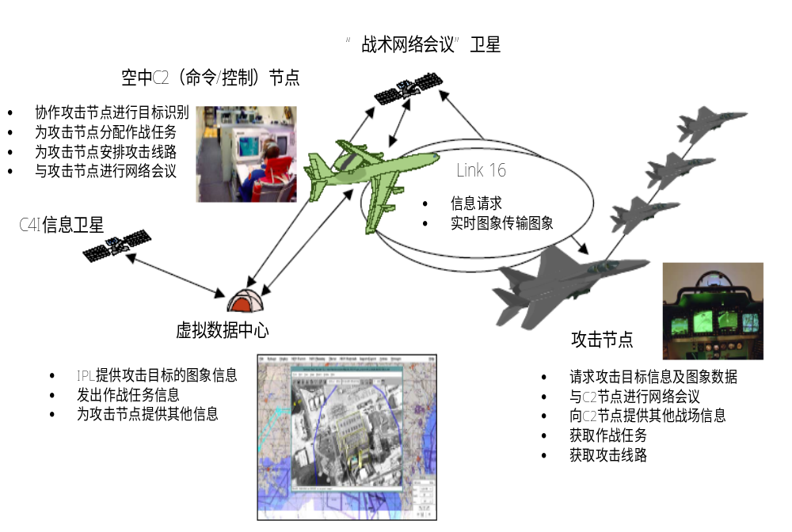

Slide 14
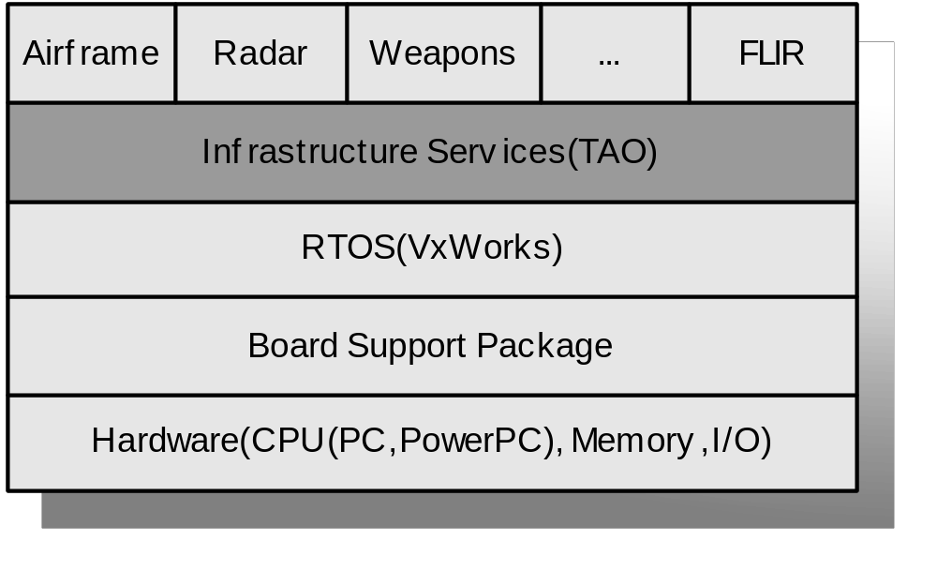
OFP (Operational Flight Program)

Slide 15
Application
…
Application
User
API
Kernel
Hardware

Slide 16
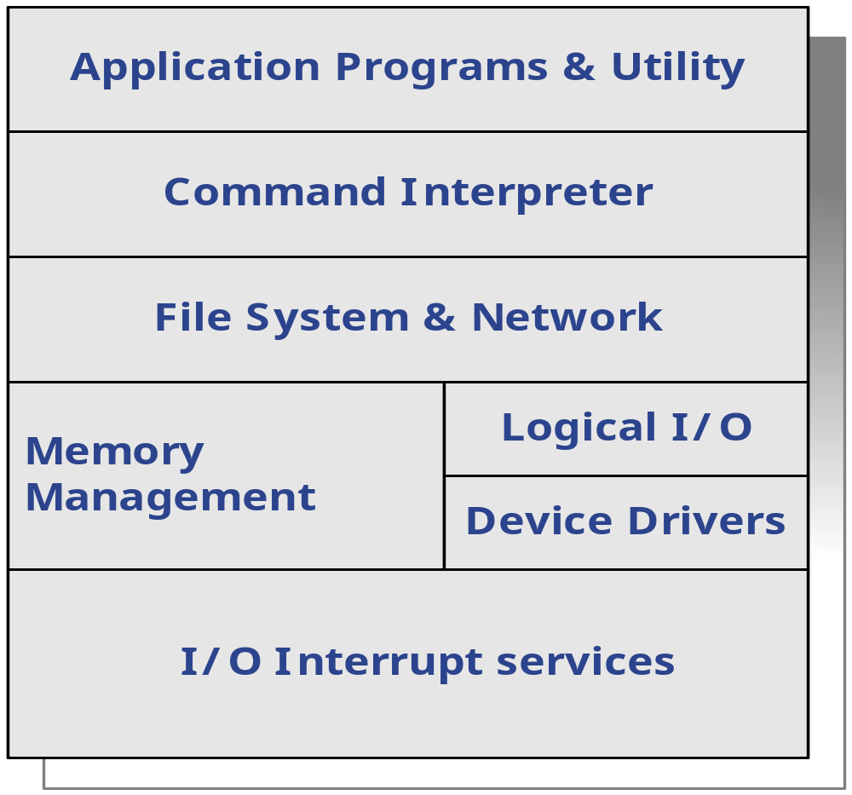

Slide 17
Application
Memory
Display
Process
File
Net
User
kernel
Micro-kernel
Safety
Security
Request
Hardware
Return

Slide 18
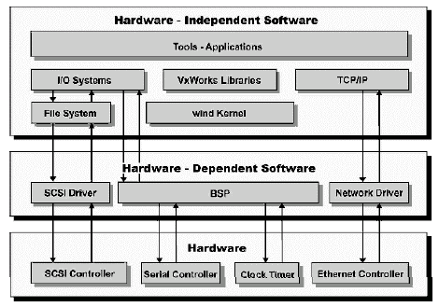

Slide 19
Application
Browser / GUI
Application
Java
Advanced Interconnect
Windows API
Advanced Networking
Networking Utility
Distributed Objects
Application
Memory Management
90%
Fault Tolerance
Multiprocessing
75%
Multiprocessing
Application
File System
File System
File System
Networking
30%
Networking
Networking
Kernel
10%
Kernel
Kernel
Kernel
Percent of total software supplied by RTOS vendor in a typical embedded device

Slide 20
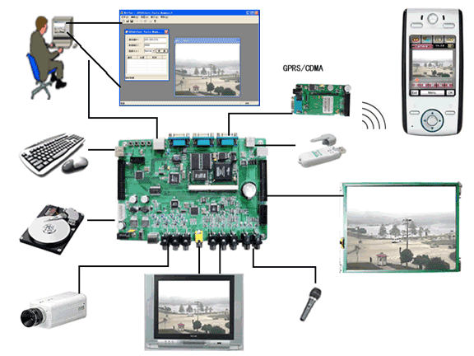

Slide 22
Tailorability
Customize

Slide 23
(1)
(2)
(3)
(4)
RomInit.s
SysALib.s
SysLib.c
SysSerial.c
(8)
(7)
(6)
BootInit.c
UsrKernel.c
UsrConfig.c
SysALib.s
(5)
BootConfig.c
UsrKernelInit()
UsrInit()
SysInit()
RomStar()
UsrKernel.c
UsrConfig.c
……
(9)
KernelInit()
(10)
UsrRoot()
How to compile & link files in the project in the Linux ?

Slide 24
Problems during the booting
    What’s the first job ?
    Where is the entry?
    How many jobs are indispensable ?
    Where is the first instruction ?
    What are boot, loader, bootloader ?
    How does the 4 cores begin to work ?

Slide 25
0x06000000
  ResetHandler:
  MRS r0, CPSR
  ORR r0, r0, #(PSR_I_BIT|PSR_F_BIT)
  MSR CPSR_c, r0
  __ENTRY:
0x80
0x40
@ Disable IRQ & FIQ
31
28
27
24
23
16
15
7
6
5
4
0
N Z C V Q
U n d e f i n e d
I F T mode
J
f
s
x
c

Slide 26
Disable IRQ & FIQ
Ensure that the MMU and caches are off
Handle secondary mpcores
initialize the UART
Load the image into the RAM
Initialize memory & Cancel remapping
Copy the vectors
Initialize the stacks & BSS
Bl acoral_start

Slide 27
0x80
0x40
  MRS r0, CPSR
  ORR r0, r0, #(PSR_I_BIT|PSR_F_BIT)
  MSR CPSR_c, r0
@ Disable IRQ & FIQ

Slide 28
LDR r1, =UART0_BASE
MOV r0, #0
STR r0, [r1,#UART_PL011_CR]
MOV r0, #0x27
STR r0, [r1,#UART_PL011_IBRD]
MOV r0, #4
STR r0, [r1,#UART_PL011_FBRD]
MOV r0, #0x70
STR r0, [r1,#UART_PL011_LCRH]
LDR r0, =0x301
STR r0, [r1,#UART_PL011_CR]
@ Disable UART
@ Set speed to 38400bps
@ 8 bits, 1 stop bit, no parity, fifo enabled
@ Enable UART

Slide 29
  MOV r0, #0
  MCR p15, 0, r0, c7, c5, 0
  MCR p15, 0, r0, c7, c6, 0
  MRC p15, 0, r0, c1, c0, 0
  BIC r0, r0, #(CTRL_M_BIT|CTRL_C_BIT)
  BIC r0, r0, #CTRL_I_BIT
  MCR p15, 0, r0, c1, c0, 0
@ Invalidate I Cache
@ Invalidate D Cache
@ Get control register
  @ Disable MMU and D Cache
@ Disable I Cache
@ Write control register
CTRL_M_BIT (1 << 0)
CTRL_C_BIT (1 << 2)
CTRL_I_BIT (1 << 12)

Slide 30
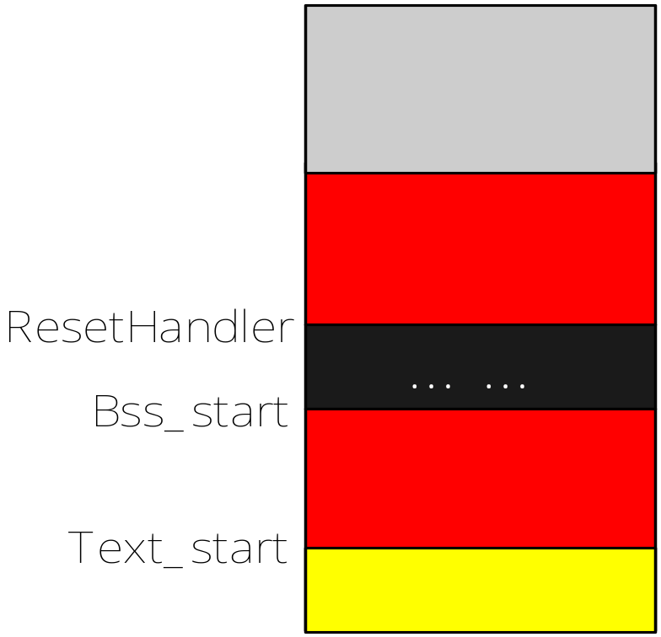
r4=0x06000078
Where is the BOOT ?
LDR r4, =dummy
ADR r1,dummy
CMP r1, r4
BXEQ r4
r4=0x40000078
@ Are we running from our load address
  ADR r1, ResetHandler
  LDR r2, =text_start
  LDR r3, =bss_start
  copyloop:
  LDR r0, [r1], #4
  STR r0, [r2], #4
  CMP r2, r3
  BCC copyloop
r1=0x40000000
r2=0x06000000
0x4000005C
0x4000004C
(0x40000000)
Norflash
(r1)
(r3)
(0x06000000)
(r2)
dummy：
(0x40000078)
INT Vector
RAM
0x00000000

Slide 31
r4=0x06000078
Where is the boot ?
LDR r4, =dummy
ADR r1,dummy
CMP r1, r4
BXEQ r4
r4=0x00000078
@ Are we running from our load address
  ADR r1, ResetHandler
  LDR r2, =text_start
  LDR r3, =bss_start
  copyloop:
  LDR r0, [r1], #4
  STR r0, [r2], #4
  CMP r2, r3
  BCC copyloop
r1=0x00000000
r2=0x06000000
0x0000005C
0x0000004C
(0x00000000)
Norflash
(r1)
(r3)
(0x06000000)
(r2)
dummy：
(0x00000078)
INT Vector
0x00000000

Slide 32
  copy_vectors:
  LDR r0, =HAL_VECTR_START
  CMP r0, #0
  BEQ real_code
  LDR r1, =HAL_VECTR_END
  MOV r2, #0
  1:
  LDR r3, [r0], #4
  STR r3, [r2], #4
  CMP r0, r1
  BLO 1b
0x1C
FIQ
0x18
IRQ
0x14
(Reserved)
0x10
Data Abort
0x0C
Prefetch Abort
0x08
Software Interrupt
0x04
Undefined Instruction
0x00
Reset

Slide 33
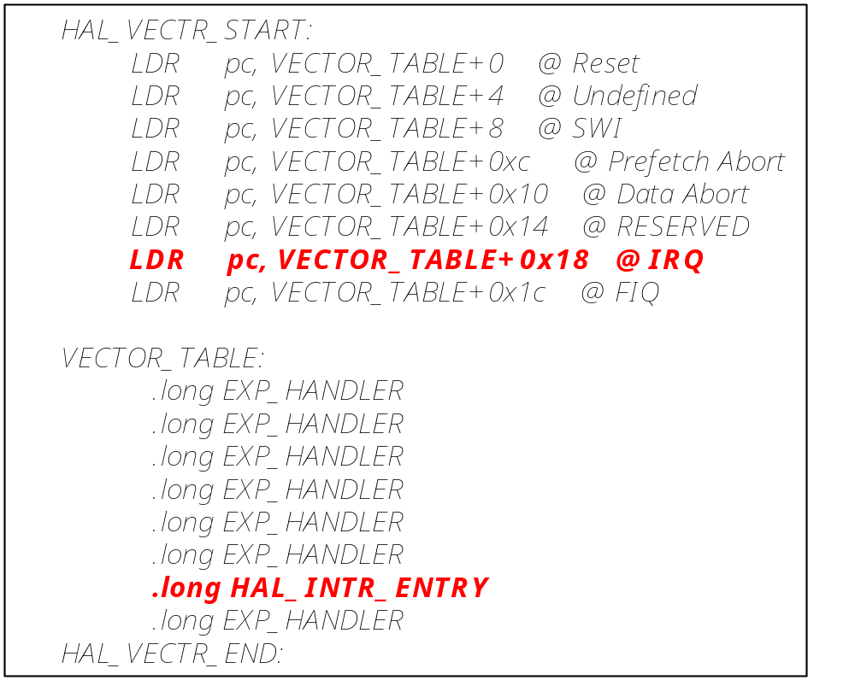
0x1C
FIQ
0x18
IRQ
0x14
(Reserved)
0x10
Data Abort
0x0C
Prefetch Abort
0x08
Software Interrupt
0x04
Undefined Instruction
0x00
Reset

Slide 34
SDRAM_BASE
0X70000000
EXD_FLASH
0X50000000
SSRAM_BASE
0X48000000
NOR_FLASH_EXD
0X44000000
NOR_FLASH
0X40000000
SC_CPU_BASE
0X1F000000
SSMC_BASE
0X100E1000
DMC_BASE
0X100E0000
UART_BASE
0X10009000
SC_BASE
0X10001000
BRD_BASE
0X10000000
RAM
0X00000000

Slide 35
MRC p15, 0, r0, c0, c0, 5
ANDS r0, r0, #0x0f
BEQ clear_leds
BL __secondary_mpcore
clear_leds:
MOV r0, #BRD_BASE
MOV r1, #0
STR r1, [r0, #BRD_LED]
@ Go if core 0 on primary core tile
0x10000000
@ Clear the LED s

Slide 36
0x1F
MRS r0,cpsr
BIC r0,r0,#MODE_MASK
ORR r1,r0,#MODE_UNDEF|NOINT
MSR cpsr_cxsf,r1 @UndefMode
LDR sp,=UDF_stack @ UndefStack=0x33FF_5C00
ORR r1,r0,#MODE_ABORT|NOINT
MSR cpsr_cxsf,r1 @AbortMode
LDR sp,=ABT_stack @ AbortStack=0x33FF_6000
ORR r1,r0,#MODE_IRQ|NOINT
MSR cpsr_cxsf,r1 @IRQMode
LDR sp,=IRQ_stack @ IRQStack=0x33FF_7000
…… ……
0x1B
0xC0
31
28
27
24
23
16
15
7
6
5
4
0
N Z C V Q
U n d e f i n e d
I F T mode
J
f
s
x
c

Slide 37
M[4:0] | Mode
10000 | User
10001 | FIQ
10010 | IRQ
10011 | Supervisor
10111 | Abort
11011 | Undefined
11111 | System

Slide 38
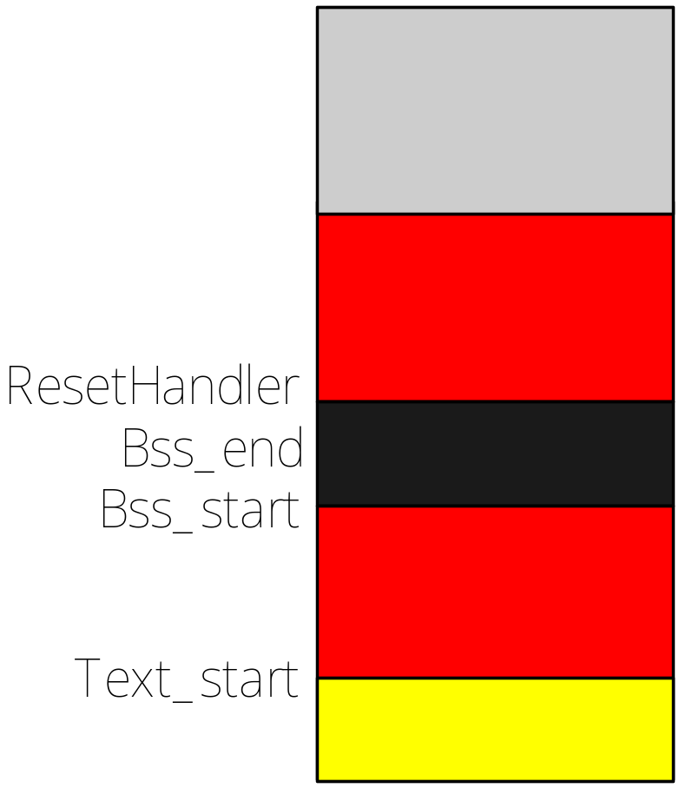
LDR R0,=bss_start
LDR R1,=bss_end
BL mem_clear
mem_clear:
MOV R2,#0
1: STR R2,[R0],#4
CMP R0,R1
BNE 1b
(R1)
(R0)
(0x06000000)
INT Vector
0x00000000

Slide 39
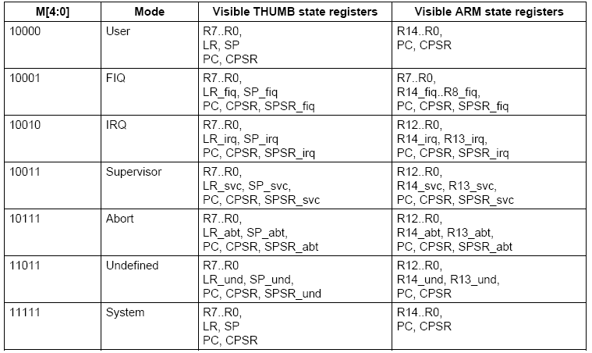

Slide 40
%include "pm.inc"
org F0000h
jmp LABEL_BEGIN
[SECTION .gdt]
LABEL_GDT: Descriptor 0, 0, 0
LABEL_DESC_CODE32: Descriptor 0, SegCode32Len - 1, DA_C + DA_32
LABEL_DESC_VIDEO: Descriptor 0B8000h, 0ffffh, DA_DRW
Base
Limit
Attribution
GdtLen equ $ - LABEL_GDT
GdtPtr dw GdtLen - 1
dd 0
SelectorCode32 equ LABEL_DESC_CODE32 - LABEL_GDT
SelectorVideo equ LABEL_DESC_VIDEO - LABEL_GDT
; END of [SECTION .gdt]
Notes:
GDT 目前只定义了三个段，根据用户需要，可以定义更多的段

Slide 41
[SECTION .s16]
[BITS 16]
LABEL_BEGIN:
cli
mov ax, cs
mov ds, ax
mov es, ax
mov ss, ax
mov sp, 0100h
@ Initialize the segment register
xor eax, eax
mov ax, cs
shl eax, 4
add eax, LABEL_SEG_CODE32
mov word [LABEL_DESC_CODE32 + 2], ax
shr eax, 16
mov byte [LABEL_DESC_CODE32 + 4], al
mov byte [LABEL_DESC_CODE32 + 7], ah
@ Initialize the code segment of 32bits

Slide 42
xor eax, eax
mov ax, ds
shl eax, 4
add eax, LABEL_GDT
mov dword [GdtPtr + 2], eax
lgdt [GdtPtr]
in al, 92h
or al, 00000010b
out 92h, al
mov eax, cr0
or eax, 1
mov cr0, eax
jmp dword SelectorCode32:0
@Initialize the GDTR
@Enable A20
@Ready to the protection mode
@Swich to the protection mode

Slide 43
[SECTION .s32]
[BITS 32]
LABEL_SEG_CODE32:
mov ax, SelectorVideo
mov gs, ax
mov edi, (80 * 11 + 79) * 2
mov ah, 0Ch
mov al, 'P'
mov [gs:edi], ax
jmp $
SegCode32Len equ $ - LABEL_SEG_CODE32
0Ch = 0000 +1100

Slide 44
1
2
3
[SECTION .gdt]
LABEL_GDT: Descriptor 0, 0, 0
LABEL_DESC_CODE32: Descriptor 0, SegCode32Len - 1, DA_C + DA_32
LABEL_DESC_VIDEO: Descriptor 0B8000h, 0ffffh, DA_DRW
Base
Limit
Attribution
%macro Descriptor
dw %2 & 0FFFFh
dw %1 & 0FFFFh
db (%1 >> 16) & 0FFh
dw ((%2 >> 8) & 0F00h) | (%3 & 0F0FFh)
db (%1 >> 24) & 0FFh
%endmacro
DA_C + DA_32 = 98h +4000h
DA_DRW = 92h

Slide 45
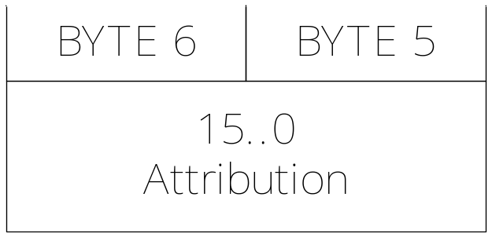
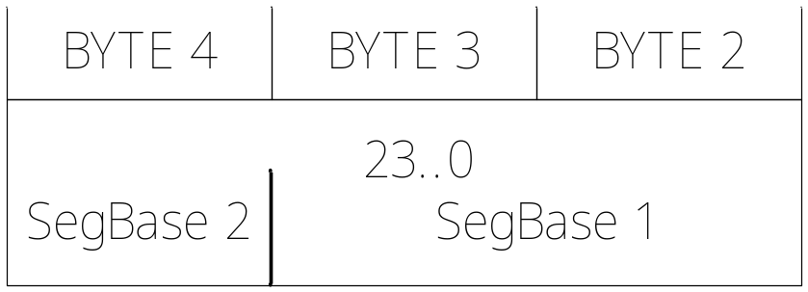
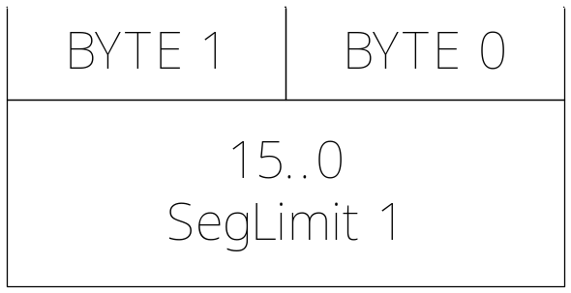
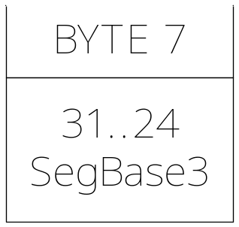
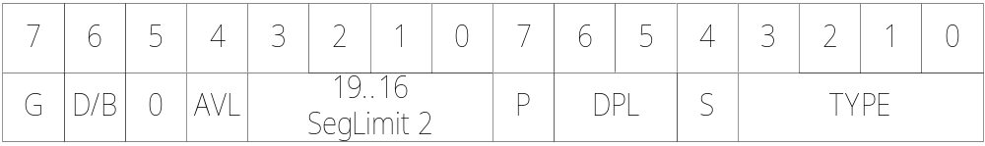
DA_C + DA_32 = 98h +4000h
DA_DRW = 92h

Slide 46
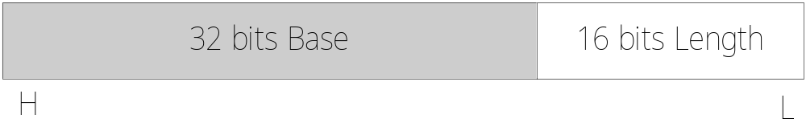
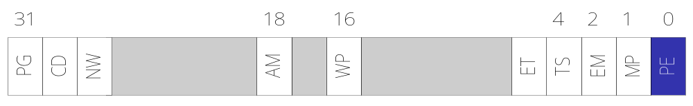
gdtr
cr0

Slide 47
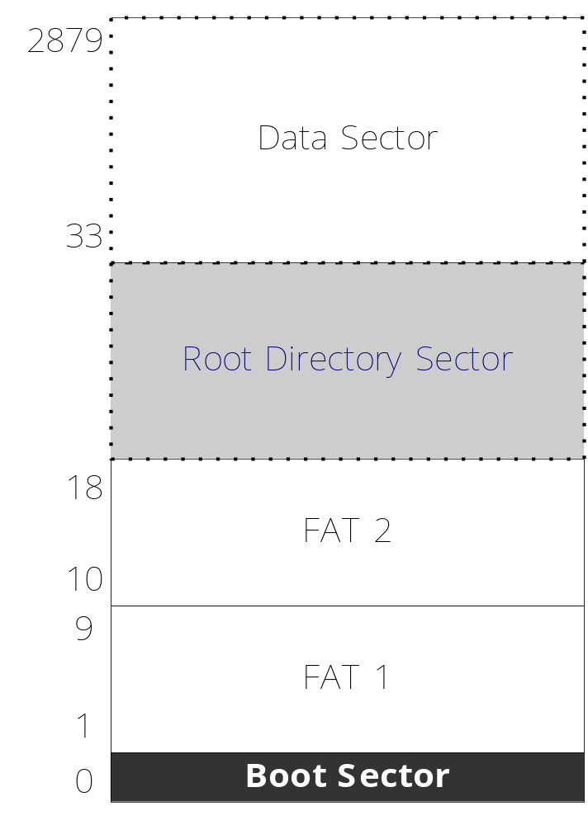








FileItem{
11 Bytes File Name
1 Byte Attribution
10 Bytes reservation
2 Bytes Update Date
2 Bytes Update Time
2 Bytes First Sector
4 Bytes File Size
}
kernel.bin
35
Floppy disk (1.44M)

Slide 48
%include "fat12hdr.inc"
... ...
mov word [wSectorNo], SectorNoOfRootDirectory
xor ah, ah
xor dl, dl
int 13h
19
@Reset the floppy
Note:
1) ah=00, dl=00 ; @Reset the floppy
2) es:bx ; @Data buffer
3) int 13 : Read data, from the given sectors, to the data buffer (es:bx), the registers used: ah,ch,dh,al,cl,dl

Slide 49
LABEL_SEARCH_IN_ROOT_DIR_BEGIN:
cmp word [wRootDirSizeForLoop], 0
jz LABEL_NO_KERNELBIN
dec word [wRootDirSizeForLoop]
mov ax, BaseOfKernelFile
mov es, ax
mov bx, OffsetOfKernelFile
mov ax, [wSectorNo]
mov cl, 1
call ReadSector
mov si, KernelFileName
mov di, OffsetOfKernelFile
cld
mov dx, 10h
14
08000h
14
0h
Kernel.bin

Slide 50
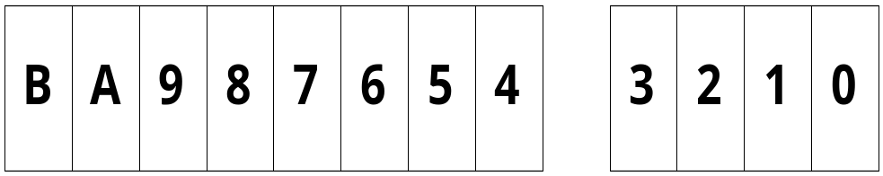
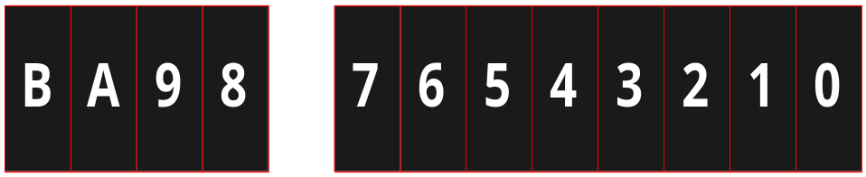
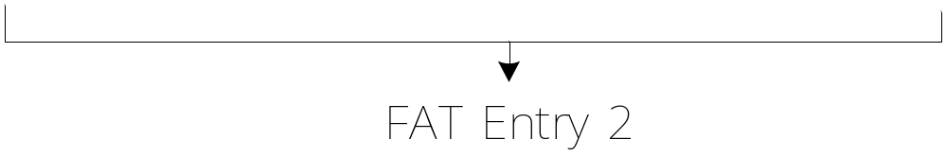
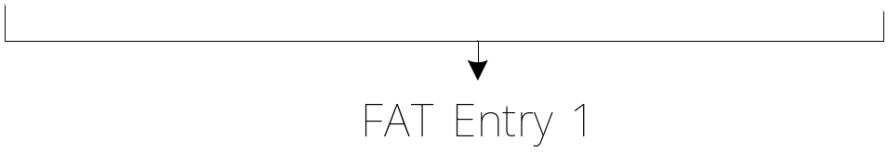
Bit map of sectors in the FAT (File Allocation Table ) 1/2
HIGH
Byte 3
Byte 2
Byte 1
LOW
0X???: The next sector
0XFF8: The last sector
0XFF7: A bad sector

Slide 51
LABEL_SEARCH_FOR_KERNELBIN:
cmp dx, 0
jz LABEL_GOTO_NEXT_SECTOR_IN_ROOT_DIR
dec dx
mov cx, 11
@Whether is a sector finished or not?
LABEL_CMP_FILENAME:
cmp cx, 0
jz LABEL_FILENAME_FOUND
dec cx
lodsb
cmp al, byte [es:di]
jz LABEL_GO_ON
jmp LABEL_DIFFERENT LABEL_GO_ON:
inc di
jmp LABEL_CMP_FILENAME
;al ← ds:si
@Compare the “kernel.bin” wtith the file name in the RAM.

Slide 52
LABEL_DIFFERENT:
and di, 0FFE0h
add di, 20h
mov si, KernelFileName
jmp LABEL_SEARCH_FOR_KERNELBIN
LABEL_GOTO_NEXT_SECTOR_IN_ROOT_DIR:
add word [wSectorNo], 1
jmp LABEL_SEARCH_IN_ROOT_DIR_BEGIN
@Go to the next item in the given sector.
@Go to the next sector in the root directory.
…
…
…
Load the kernel

Slide 53
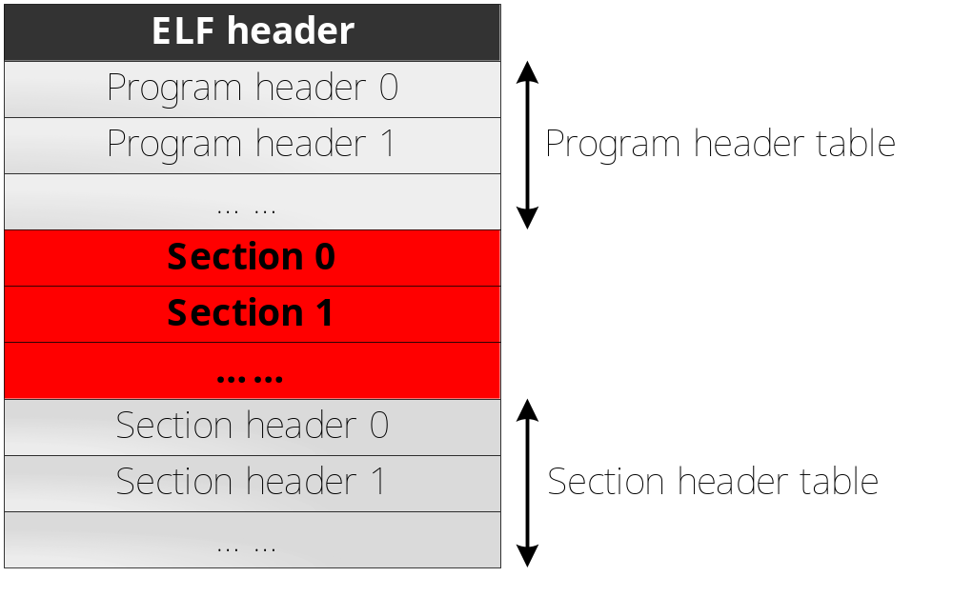
Executable and Linkable File (ELF)

Slide 54
typedef struct {
unsigned char e_ident[EI_NIDENT];
Elf32_Half e_type;
Elf32_Half e_machine;
Elf32_Word e_version;
Elf32_Addr e_entry;
Elf32_Off e_phoff;
Elf32_Off e_shoff;
Elf32_Word e_flags;
Elf32_Half e_ehsize;
Elf32_Half e_phentsize;
Elf32_Half e_phnum;
Elf32_Half e_shentsize;
Elf32_Half e_shnum;
Elf32_Half e_shstrndx;
} Elf32_Ehdr;
7F 45 4C 46
80000h
34h
34h
20h
28h
ELF Header

Slide 55
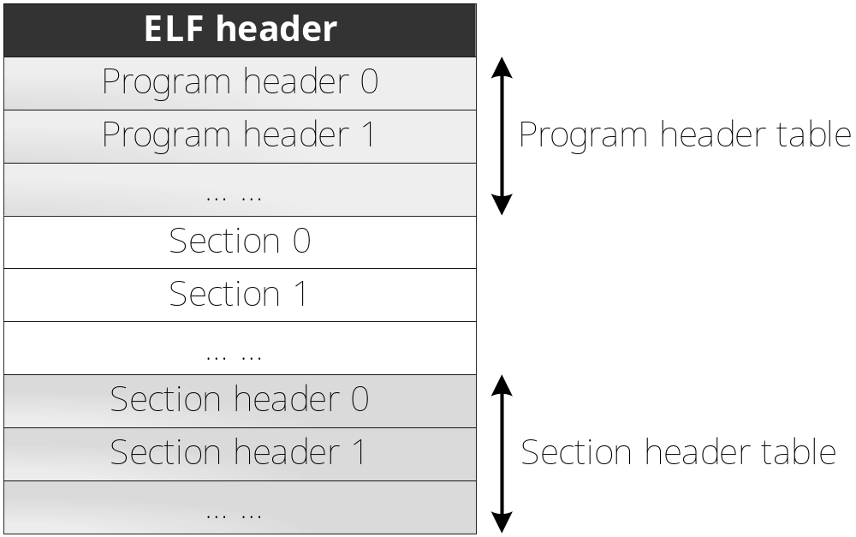
34h
20h
28h

Slide 56
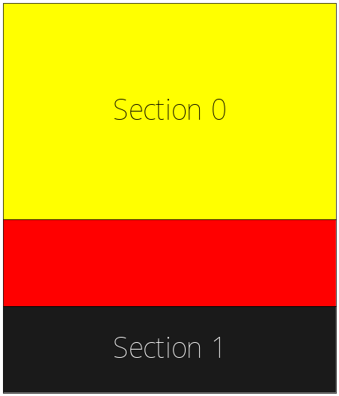
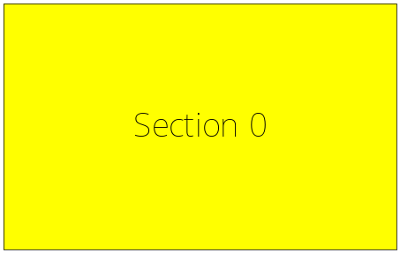


typedef struct
{
Elf32_Word p_type;
Elf32_Off p_offset;
Elf32_Addr p_vaddr;
Elf32_Addr p_paddr;
Elf32_Word p_filesz;
Elf32_Word p_memsz;
Elf32_Word p_flags;
Elf32_Word p_align;
} Elf32_Phdr;
08000h
50h
181h
080131h
080134h
184h
18Ch
08013Ch
Program Header
In the File
In the RAM
Where’s the kernel loaded from?

Slide 57
ASM = nasm
ASMFLAGS = -I include/
TARGET = boot.bin loader.bin
.PHONY : everything clean all
everything : $(TARGET)
clean : rm -f $(TARGET)
all : clean everything
boot.bin : boot.asm include/load.inc include/fat12hdr.inc
$(ASM) $(ASMFLAGS) -o $@ $<
loader.bin : loader.asm include/load.inc include/fat12hdr.inc include/pm.inc
$(ASM) $(ASMFLAGS) -o $@ $<

Slide 58
BWSCON EQU 0X48000000
BANKCON6 EQU 0X4800001C
REFRESH EQU 0X48000024
BANKSIZE EQU 0X00000028
MRSRB6 EQU 0X4800002C
LDR R0,=BWSCON
LDR R1,=0X22111110
STR R1,[R0]
LDR R0,=BANKCON6
LDR R1,=0X00018005
STR R1,[R0]
… …
@ Access by 32 Bits
@ Set the BANK6 to RAM
Refer to the “HY57V561620(L)T”

Slide 59
